Slide 1
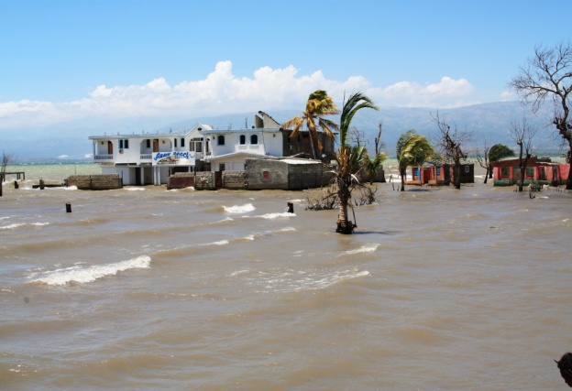
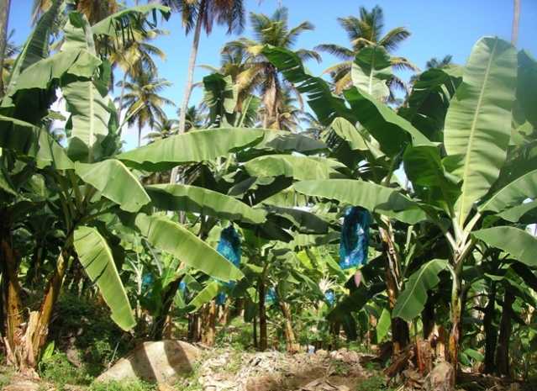
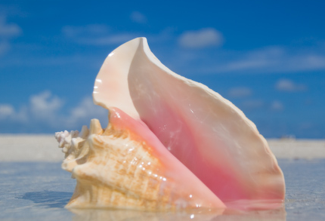
Valuing the Caribbean environment: policy processes linked with SEEA
Charles Davies, UNEP Regional Office for Latin America and the Caribbean
6 February 2014

Slide 2
Latin American and Caribbean Initiative for Sustainable Development (ILAC)
Notes:
Adopted in 2002 by Heads of State in the margins of Earth Summit
Framework of 7 priority areas, specific activities, guiding goals and indicators

Slide 3
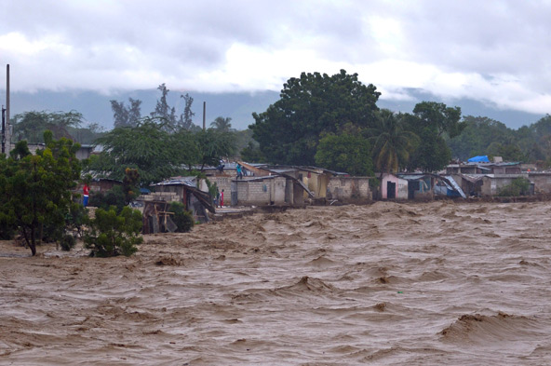
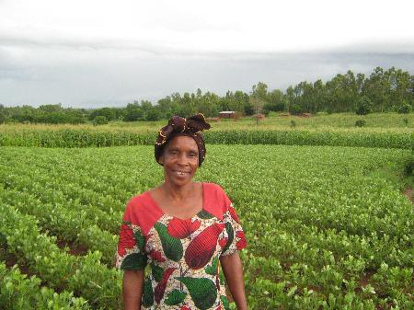
Green economy and SCP in the Caribbean: shared challenges and opportunities
Green economy and sustainable consumption and production (SCP) offer complementary approaches for an action-oriented agenda of sustainable development.
They address, respectively, macro- and micro-economic dimensions of public policy and regulation, business operations and consumption choices.
National programmes led by countries based on their demand – with support from UNEP as well as partners such as UNIDO, UNITAR and ILO—Partnership for Action on Green Economy (PAGE)
Programmes address common challenges in the Caribbean—vulnerability to climate change and extreme weather events, limited economic diversification and vulnerability to external price shocks.
Notes:
3

Slide 4
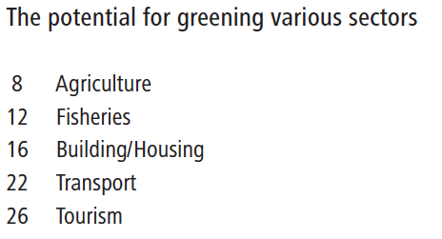
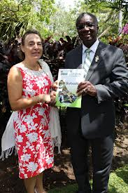
Green Economy Scoping Study for Barbados (2012)
Opportunities, challenges and investment gaps
Specific measures for greening of sectors and potential economic, social and environmental returns
Strong participatory stakeholder engagement

Slide 5
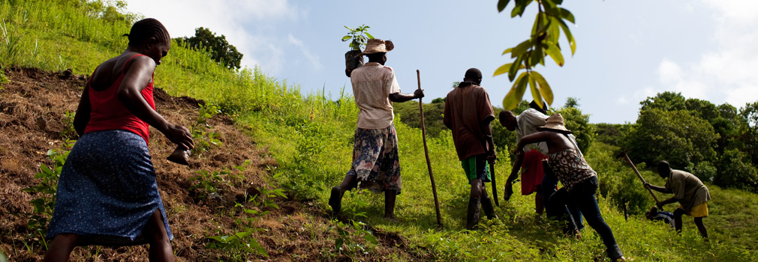
Advancing Caribbean States’ Sustainable Development through Green Economy (ACSSD-GE) (2012-2014)
This project is supporting three pilot countries (Haiti, Jamaica and Saint Lucia), which were selected by COTED an open application process.
Simultaneously, the project engages with other countries in the Caribbean region and provides macroeconomic and sector specific green economy capacity building support through regional events (e.g., Caribbean Green Economy Conference 2013)

Slide 6
Sustainable consumption and production in the Caribbean
LAC was the first region to develop a SCP Regional Strategy, with the following priorities (endorsed by the Forum of Environment Ministers):
National SCP action plans
Sustainable public procurement
Small and Medium Enterprises
Education and sustainable lifestyles
Regional Council of Experts on SCP
Sustainable public procurement and ecolabelling (combined approach to improve performance of products through lifecycle)
Sustainable tourism and Green Passport Campaign: Bahamas, OECS, Caribbean Tourism Organization
Resource efficient and cleaner production in SMEs: UNEP/UNIDO National Cleaner Production Centres, eco-innovation tools, waste minimization and waste-to-energy

Slide 7
ProEcoServ Trinidad and Tobago: Objectives
Introduce GIS-based ecosystem service maps and an associated Decision Support System into Spatial Development Planning in T&T
National Spatial Development Plan
National Hillside Policy
Introduce Experimental Ecosystem Services Accounting into the T&T National Accounts
Develop a pilot Eco-finance scheme (e.g. Payment for Ecosystem Services)
T&T Green Fund
Reference: “Environmentally adjusted National Accounts for Trinidad and Tobago’s sustainable future”, Alexander Girvan and Sonja S. Teelucksingh
Notes:
4 Year GEF SGP funded project
4 Pilot sites ( Trinidad and Tobago , Vietnam , South Africa, Chle
Executed by the University of the West Indies
Looks at 3 Pilot sites ( Bucco Reef, Nariva swamp, Nothern Range) in Trinidad and Tobago and conducts biophysical assessment of volume of ecosystem service delivered and their importance to local and national well being
Objective # 2 is to be achieved thought the use of valuation and mainstreaming of ecosystem services thinking into policy making circles.

Slide 8
Valuation in ProEcoServ
ProEcoServ uses valuation of ecosystem services to;
Speak the language of Policymakers/population
Convert the wealth of biophysical knowledge on forest into economic values
Draw attention to the flows in the economy which impact ecosystem health
$497 Million¹ - Value of key ecosystem services² provided by northern range forest per year
2.4% of GDP for one ecosystem = strong case for SEEA to track and monitor these critical flows
Also a TEEB (The Economics of Ecosystems and Biodiversity) study in Saint Lucia – coraf reefs and marine protected areas, rainforest, fisheries and shoreline protection, focusing on the tourism sector
Notes:
Valuation has been selected as a critical tool for pushing introducing SEEA to national policymakers as
Economics is the dominant language of policymaking and valuation is a translation tool for environmental considerations
Communicates the importance of the environment to policymakers and citizens
It quantifies the relative contribution of the environment to the economy
497 Million (2.4% of GDP) is for ONE ecosystem ( albeit the one largest). We MUST track these flows in SEEA and accounts for proper management

Slide 9
Intergovernmental Platform on Biodiversity and Ecosystem Services (IPBES)
Goal to “strengthen the science-policy interface for biodiversity and ecosystems services for the conservation and sustainable use of biodiversity, long-term human well-being and sustainable development”.
Four functions: knowledge generation, assessment, policy support, capacity building
2nd Plenary (December 2013) adopted Programme of Work 2014-2018, including:
Regional and subregional assessments
Assessment of tools and methodologies regarding multiple values of biodiversity to human societies.
Notes:
Valuation has been selected as a critical tool for pushing introducing SEEA to national policymakers as
Economics is the dominant language of policymaking and valuation is a translation tool for environmental considerations
Communicates the importance of the environment to policymakers and citizens
It quantifies the relative contribution of the environment to the economy
497 Million (2.4% of GDP) is for ONE ecosystem ( albeit the one largest). We MUST track these flows in SEEA and accounts for proper management

Slide 10
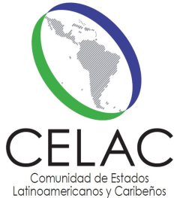
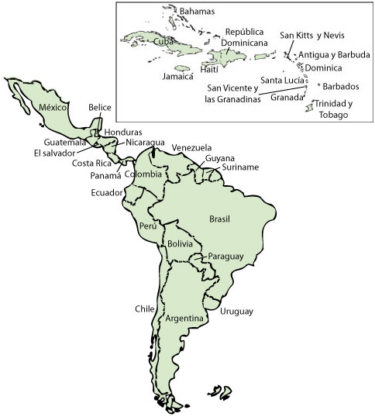
Subregional and regional entities

Slide 11
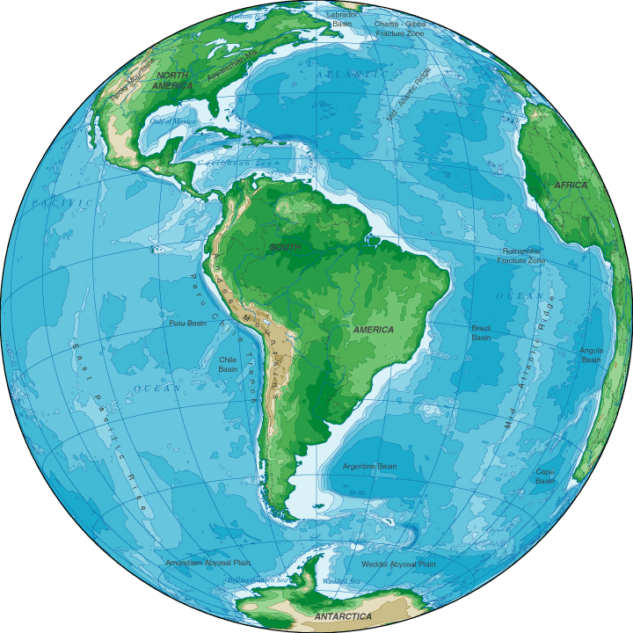
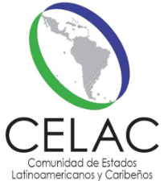
Latin America and the Caribbean (regional)
Community of Latin America and Caribbean States (CELAC)
All 33 countries in region
Incorporates Montego Bay Action Plan
Specialized ministerial meetings on environment and other themes
ALBA Group
Eight countries from Latin America and Caribbean
Joint Declaration of 2004 (12 principles and priorities)
Joint statements on environment and climate change issues
Committee for Nature Protection
Grannational projects
Development Banks
Latin American Development Bank (CAF)—Environmental Strategy
Inter-American Development Bank—Sustainability Report and annual lending target on climate change, renewable energy and environmental sustainability
Organization of American States (OAS)
35 States of Americas, 67 other observers
Declaration and Plan of Action on Sustainable Development of Americas
Inter-American Meetings of Ministers and High-level Authorities on Sustainable Development

Slide 12
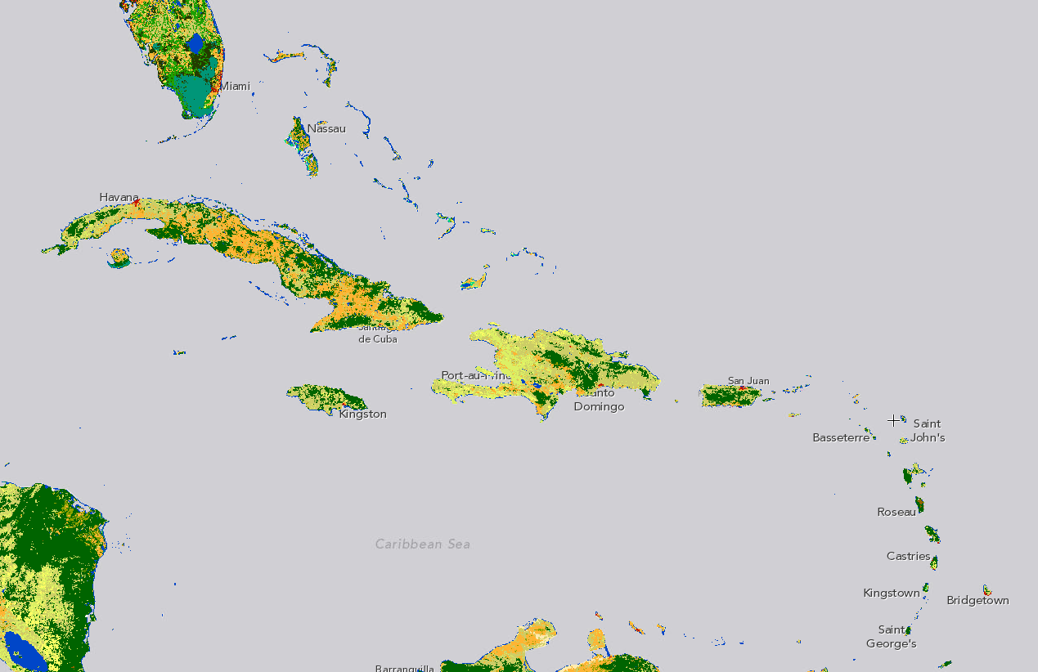
Caribbean policies, priorities, strategies
Association of Caribbean States (ACS)
25 member States in wider Caribbean region
Priorities include sustainable tourism, disaster risk reduction, preservation and conservation of the Caribbean Sea—Caribbean Sea Commission
Organisation of Eastern Caribbean States (OECS)
Nine small island members and associate members in eastern Caribbean
St George´s Declaration of Principles for Environmental Sustainability in the OECS (21 principles)—framework for monitoring and regional indicators
Caribbean Community (CARICOM)
Revised Treaty of Chaguaramas—move to Single Market and Economy—various environmental protection provisions
Port of Spain Accord (1989)
CARICOM Environment and Natural Resources Policy Framework under development
Cartagena Convention for the Protection and Development of the Marine Environment in the Wider Caribbean Region
Ratified by 25 UN Members in Wider Caribbean
Three thematic protocols—oil spills; specially protected areas and wildlife; pollution from land-based sources

Slide 13
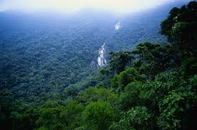
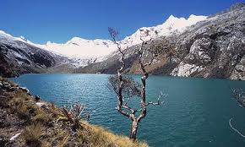
Priorities of nearly every organization/subregion in Latin America and the Caribbean
Climate change
Biodiversity, natural resources, ecosystems, protected areas
Water resource management

Slide 14
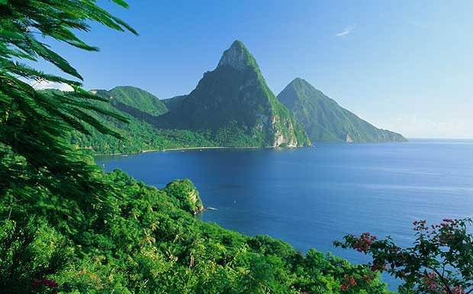
Thank you!

